Slide 1
Parasocial relationships

Slide 2
The evolutionary explanations for partner preferences, including the relationship between sexual
selection and human reproductive behaviour.
Factors affecting attraction in romantic relationships: self-disclosure; physical attractiveness,
including the matching hypothesis; filter theory, including social demography, similarity in attitudes
and complementarity.
Theories of romantic relationships: social exchange theory, equity theory and Rusbult’s investment model of commitment, satisfaction, comparison with alternatives and investment. Duck’s phase model of relationship breakdown: intra-psychic, dyadic, social and grave dressing phases.
Virtual relationships in social media: self-disclosure in virtual relationships; effects of absence of
gating on the nature of virtual relationships.
Parasocial relationships: levels of parasocial relationships, the absorption addiction model and the
attachment theory explanation.

Slide 3
Syllabus
Parasocial relationships | Levels of parasocial relationships
 | The absorption addiction model
 | The attachment theory explanation.

Slide 4
Parasocial relationships
Parasocial relationships are one-sided relationships, where one person extends emotional energy, interest and time, and the other party, the persona, is completely unaware of the other's existence (outside of ones real social network). Parasocial relationships are most common with celebrities, organizations (such as sports teams) or television stars.
Who do you follow on twitter – why!

Slide 5
January 24
What is the difference between para-social interaction and a para-social relationship?
  Para-social interaction describes the individual instances of mediated communication between persona and spectator, whereas a para-social relationship refers to the bond that is formed with the persona through routine experience and over time.

Slide 6
Why is this important?
It is believed that it occurs mostly around 11 – 17 and that the more education the less likely it is to happen.
The relationship resembles physical interpersonal relationships eg: friendship, in many ways such as they are voluntary , provide companionship and are preceded by attraction.
There are gender differences females are interested in the entertainment world and boys in sports.
It was perceived as abnormal but more recently it is seen as a positive method to develop through observation and imitation of positive role models – think Bandura and SLT. (Social Learning theory)

Slide 7
Research
Giles: Younger people attracted to media personalities more than older people.
McCutcheon: Negative correlation -0.4 between the amount of education and celebrity worship. So less education more likely to pursue parasocial relationship.
Thompson: Parasocial relationships meet many of the same criteria of real relationships.

Slide 8
Evaluation
Young people interact more with media which explains age difference. I.e.: I do not watch x on the beach so could not form a parasocial relationship.
How is data collected? What are the problems?
Correlation. What is the problem? Give an alternative explanation.
Could parasocial relationship be used in advertisement. What could be the dangers - thinks SLT and negative (eating).

Slide 9
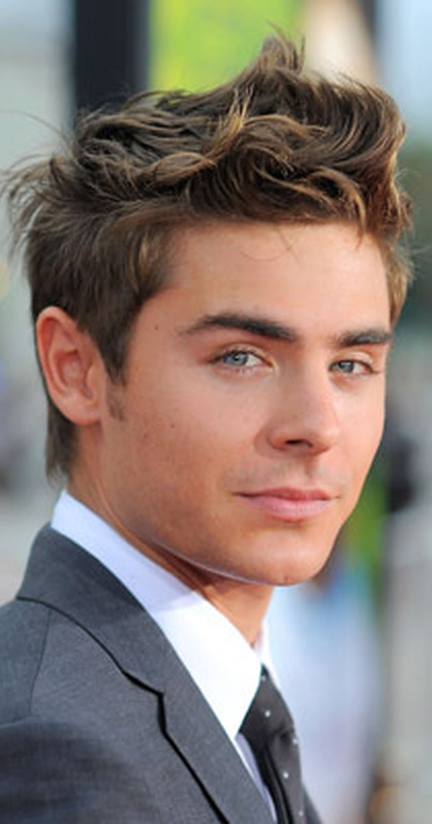
Case study
Paula is a 14 year old girl and has become fascinated by Zack Efron. She has bought a number of posters of him and has put them on her wall.
She has bought a number of films that he has been in and has watched 17 again over and over again. She has requested to go and see him in concert when he comes in February.
Her father has become worried that her unhealthy obsession will be bad for her development. Should he try and stop this relationship?

Slide 10
These relationships may be appealing because they make few demands, and the individual does not run the risk of criticism or rejection as might be the case in a face to face relationship.

Slide 11
Syllabus
Parasocial relationships | Levels of parasocial relationships
 | The absorption addiction model
 | The attachment theory explanation.

Slide 12
Levels of parasocial relationships
Relationships can grow stronger. We can immerse ourselves in our media consumption. Following somebody on twitter and watching their program as soon as it is out. Buying memorabilia becoming obsessed with the personality.

Slide 13
Celebrity Attitude Scale
Entertainment –social scale – measures social aspects such as discussing personalities with friends.
Intense personal sub scale Measures strength of feeling and levels of obsession about personalities.
Borderline pathological sub scale – measures levels of uncontrollable feelings and behaviour about media personalities.
So those who become obsessed will have a higher score which leads to:

Slide 14
Syllabus
Parasocial relationships | Levels of parasocial relationships
 | The absorption addiction model
 | The attachment theory explanation.

Slide 15
Absorption Addiction model
Maltby et al. (2006) used the Celebrity Attitude Scale (McCutcheon et al., 2002) in a large scale survey and classified responses into three levels of behaviours and beliefs linked to relationships with celebrities.
Entertainment-Social is the least extreme relationship type. The person sees the celebrity as a source of entertainment and may speak about them often with like-minded friends. Examples could be discussions about soap operas or reality television stars. They find them interesting.
Intense-Personal relationships occur when people connect aspects of the celebrity to their own identity. They may have a strong feeling that they should have a real life relationship with the celebrity and believe that they share a kinship. (Just the same)
Borderline pathological relationships are used to describe the actions of someone who displays obsessive behaviours relating to a celebrity. They may invest a large number of resources in meeting or attempting to befriend the celebrity, for example by sending them personal gifts.

Slide 16
Research
Have a go at the CAS questionnaire.
Maltby et al: Found that those who were extrovert (Eysenck’s personality questionnaire) tended to be on the entertainment social level whereas those who scored highly on neuroticism tended towards intense personal level. This suggests that personality has an effect.
Maltby et al: found that those on the entertainment social level were mentally healthy whereas those on intense personal level showed poor mental and physical health.

Slide 17
Evaluation
We are attracted to people who entertain.
We become interested in celebs when we are looking for direction eg; as a teenager. This can become obsessive at a time of crisis eg; the loss of a loved one.

Slide 18
Syllabus
Parasocial relationships | Levels of parasocial relationships
 | The absorption addiction model
 | The attachment theory explanation.

Slide 19
Attachment theory explanation.
You tell me?

Slide 20
Research
Cole and lees: Adolescents with insecure resistant more likely to have a parasocial relationship. Supports the idea that they are more susceptible to this.
McCutcheon found that there was no relationship between parasocial relationship and attachment type at the entertainment level but at the higher levels then there was.

Slide 21
Evaluation
Bowlby theory of maternal deprivation.
Bowlby theory including the idea of the internal working model.
All of these support the idea that attachment will have an affect on parasocail relationships.

Slide 22
Would you change your advice?
Paula is a 14 year old girl and has become fascinated by Zack Efron. She has bought a number of posters of him and has put them on her wall.
She has bought a number of films that he has been in and has watched 17 again over and over again. She has requested to go and see him in concert when he comes in February.
Her father has become worried that her unhealthy obsession will be bad for her development. Should he try and stop this relationship?

